Slide 1

STAFFORDSHIRE DIVERS
Understanding and
Using Your
Dive Computer
What the numbers mean
Planning and monitoring
Warnings and stops
Your own computer
Bring your dive computer and manual
Club session with discussion and practice: 60 minutes
Notes:
A practical refresher for mixed club divers, accessible to Ocean Divers. Ask members to bring their computers and current manuals. This session does not replace qualified instruction or qualify anyone for planned decompression.
60-minute run-of-show using the final slide numbers:
0–7 min: slides 1–5, foundations and a guided screen demonstration.
7–21 min: slides 6–12, NDL, buddy limits, conservatism, ascent and stops.
21–32 min: slides 13–17, planning, settings and warning-response practice.
32–43 min: slides 18–21, unplanned decompression and computer failure.
43–45 min: slide 22, post-dive checks.
45–52 min: slide 23, seven-minute own-computer exercise.
52–55 min: two decision checks and closing takeaways on slide 23.
55–60 min: questions and contingency.
Slides 24–26 are optional reference material after the main close. Use only if time remains or in a separate follow-up.
Before delivery: review emergency-response wording and the current manuals for the actual models present. Open the Suunto Zoop Novo warning guidance and each group’s manual. The club’s confirmed response to computer failure, including no personal backup, is to abort the dive. Brief the controlled-ascent procedure within members’ training.
Sources for the warning activity:
https://www.suunto.com/Support/Product-support/suunto_zoop_novo/suunto_zoop_novo/features/alarms-warnings-and-notifications/

Slide 2
What we want to achieve
BY THE END, YOU SHOULD BE ABLE TO
OPENING QUESTION
01
Identify key screen information
Have you ever seen a warning underwater and been unsure what it meant?
02
Explain your no-decompression limit
03
Recognise ascent and oxygen warnings
04
Distinguish safety and decompression stops
05
Check your settings before diving
02
Notes:
The focus is ordinary Ocean Diver diving. Ocean Divers have a maximum depth of 20 metres and should plan dives without mandatory decompression stops. Understanding a decompression display helps you recognise a problem, but planned decompression requires further training.
Opening question: Who has seen a symbol or warning underwater and been unsure what it meant?
Sources supplied by organiser:
https://www.bsac.com/training/learn-to-scuba-dive/ocean-diver-course/

Slide 3
How a dive computer works
THE INPUTS
Pressure
Time at depth
Selected gas
Calculates depth
Records your profile
Uses the entered mix
A mathematical model estimates inert gas loading
The computer updates its calculations throughout the dive.
03
Notes:
Your computer follows your actual depth profile rather than treating the whole dive as time spent at maximum depth. It estimates what is happening inside your body. It cannot directly measure your nitrogen loading or guarantee freedom from decompression illness.
Sources supplied by organiser:
https://www.bsac.com/safety/safe-diving-guide/equipment/
The algorithm does the calculations, but the diver must understand the display and act. On ordinary air and nitrox dives, nitrogen is the inert gas chiefly discussed. The computer estimates loading from recorded depth, time and selected gas. It cannot directly measure gas in the body or guarantee freedom from decompression illness. Ask what happens if the selected gas is incorrect. This leads into the gas-setting lesson.

Slide 4
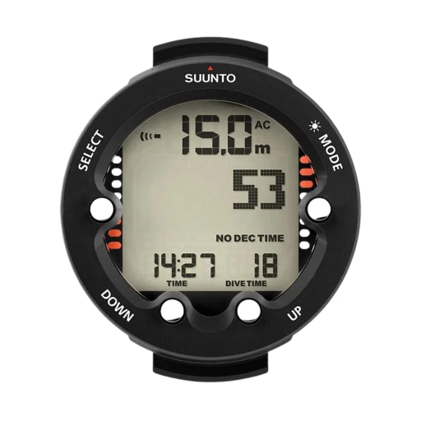
The information you need most
Display | Meaning
Current depth | Your depth now
Dive time | Elapsed time for this dive
Maximum depth | Deepest point reached
NDL / No Deco / No Stop | Time at this depth before required decompression
Ascent indicator | How quickly you are ascending
Gas setting | Oxygen percentage used for calculations
Suunto Zoop Novo
First find current depth together. Then locate the other fields on your own model.
04
Notes:
Screen layouts differ. Some information appears on the main screen, while other information requires a button press.
Activity: ask members to locate the six fields on their own computer or a photograph of its dive screen. Compare the Suunto Zoop Novo, Mares Puck Pro / Pro+, and Cressi Leonardo. Use each model’s own manual rather than assuming identical buttons or labels.
Sources supplied by organiser:
https://www.suunto.com/en-us/Support/Product-support/suunto_nautic_s/suunto_nautic_s/safety/dive-safety/
Model references supplied by organiser: https://www.suunto.com/Products/dive-computers-and-instruments/Suunto-Zoop-Novo/Suunto-Zoop-Novo-Black/
https://www.mares.com/product/puck-pro-7
https://store.cressi.com/products/leonardo-computer
Image supplied by organiser: Suunto Zoop Novo. Product display example only, not a dive plan. Refer to the model’s current manual. Image pixels and readings have not been altered.
Guided activity: first point to the current-depth field in the Zoop Novo photograph and distinguish it from maximum depth. Ask a member to identify the same field on their own manual dive-screen image. Then work through dive time, maximum depth, NDL, ascent indicator and selected gas. Surface screens may not show all dive fields. Do not change settings during this exercise.

Slide 5
Other numbers you may see
ASCENT AND STOPS
GAS AND OXYGEN
TTS / ASC TIME
MOD
Estimated time to reach the surface
Maximum depth for the gas and oxygen limit
CEILING
CNS / OTU
Shallowest permitted depth during required decompression
Calculated oxygen exposure indicators
STOP
Tank pressure / gas time
Stop depth and remaining time
On compatible air-integrated computers
Everyone must monitor remaining gas, using air integration or a separate pressure gauge.
05
Notes:
TTS can include ascent and required stops. Check whether your model includes a safety stop. Gas time depends on assumptions and your breathing rate. It needs to be considered alongside the gas reserve agreed in your dive plan.
Model comparison: Suunto D5 has optional wireless cylinder-pressure monitoring. Shearwater Peregrine TX adds air integration and a compass compared with Peregrine. These features require compatible equipment. Ask members to show which fields their own unit provides.
Sources supplied by organiser:
https://cms-edit.suunto.com/en-gb/Support/Product-support/suunto_nautic_s/suunto_nautic_s/dive-setup/key-information-during-diving/
https://us.suunto.com/pages/suunto-d5-user-guide
https://shearwater.com/pages/peregrine-support
Keep CNS/OTU and estimated gas time as recognition items, not a technical deep dive. Everyone must monitor remaining gas and the agreed reserve, including divers whose computers have no air integration.

Slide 6
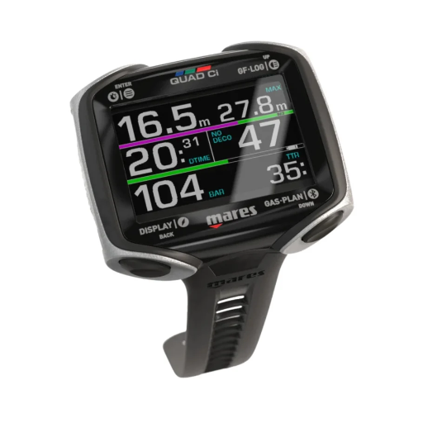
Understanding your NDL
NDL
No-decompression
limit
Remaining time at your current depth
Going deeper usually reduces it
Moving shallower may increase it
Earlier dives can reduce it
Mares Quad Ci
NDL does not tell you how much gas remains.
06
Notes:
NDL 10 means approximately ten more minutes at that depth before your computer predicts required decompression. It does not mean ten minutes of gas remaining or permission to stay regardless of your dive plan.
Sources supplied by organiser:
https://cms-prod.suunto.com/en-bz/Support/Product-support/suunto_nautic/suunto_nautic/dive-setup/key-information-during-diving/
Image supplied by organiser: Mares Quad Ci product display. The image shows NO DECO 47. Point out this field separately from the tank-pressure reading. Product display example only, not a dive plan. Original pixels, proportions and displayed readings are unchanged.
Before required decompression, NDL means time remaining at the current depth before the model predicts required stops. Leave a margin. Ocean Divers plan dives without required decompression. If required stops appear, follow the later unplanned-decompression guidance. Sources: https://www.bsac.com/safety/safe-diving-guide/equipment/

Slide 7
A practical NDL example
AT 18 METRES
Illustrative readings, not a dive plan
YOUR COMPUTER
YOUR BUDDY’S COMPUTER
8 min
4 min
Both have adequate gas for the agreed ascent.
Would you stay another eight minutes?
07
Notes:
Illustrative readings, not a dive plan. You are at 18 metres. Your computer shows NDL 8 minutes. Your buddy shows NDL 4 minutes. Both still have adequate gas for the agreed ascent.
Discussion: Would you stay another eight minutes? Pause for answers before revealing the explanation verbally.
The buddy pair needs to act on the more restrictive limit. Signal, agree the change and begin the planned departure or ascent with a margin. Moving shallower may improve NDL, but you should not rely on that to rescue an overextended dive.
After discussion say clearly: act on the more restrictive limit and leave a margin. Ask a member why eight minutes on their own display is insufficient. Do not turn the shorter reading into a target to use up.

Slide 8
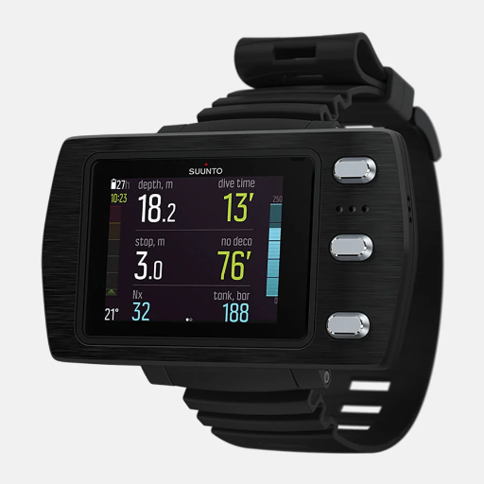
Why buddies see different limits
01
Different algorithms or conservatism settings
02
Different gas settings
03
Different depths during the dive
04
Different earlier dives and surface intervals
Suunto EON Steel Black
Each diver needs a computer that has followed their own dive history.
08
Notes:
Compare settings before the dive. Different readings do not automatically mean one computer is faulty. Each diver needs a computer that has followed their own dive history. Borrowing a buddy’s reading does not recreate your personal exposure.
Sources supplied by organiser:
https://cdn.shopify.com/s/files/1/0838/3732/1530/files/Peregrine_Manual-metric_2021.pdf?v=1710186733
Image supplied by organiser: Suunto EON Steel Black. Product display example only, not a dive plan. Refer to the model’s current manual. Image pixels and readings have not been altered.
Surfacing does not clear all inert gas at once. During a dive the body takes up inert gas, and after a dive it releases it gradually. Different model compartments respond at different rates. Earlier dives and surface time therefore affect the next dive. Ask: Could buddies start with different limits if only one dived this morning? Yes. Each needs a computer that recorded their own history. Source: https://shearwater.com/pages/peregrine-support

Slide 9
Conservatism in plain English
Conservatism settings change the calculated limits.
A more cautious setting may mean:
Less no-stop time
Longer required stops
The computer asks you to
leave depth sooner.
If decompression is required,
the stop time may increase.
Using less conservative settings to stay down longer can leave less decompression safety margin if an uncontrolled ascent occurs. Remaining within the displayed no-stop limit does not guarantee safety.
Understand a setting before changing it.
09
Notes:
Allow 1–2 minutes. Say: “A more cautious setting generally gives you less no-stop time or more time at required stops. The exact effect depends on the computer and the dive.”
Some computers offer named personal or conservatism settings. Bühlmann-based computers may offer gradient factors. You do not need to work through their equations tonight. Gradient factors do not tell you a percentage chance of being safe.
Avoid changing a setting just to get a longer dive, shorter stops or the same reading as a buddy. Check the current manual and seek appropriate instruction before using unfamiliar or custom settings. No setting removes all decompression risk.
Activity: ask members to find their conservatism setting without changing it. The optional reference section after the main close covers GF Low and GF High.
Sources:
https://shearwater.com/blogs/community/flexible-control-of-decompression-stress
https://www.suunto.com/Support/Product-support/suunto_d5/suunto_d5/features/personal-setting/
https://shearwater.com/pages/peregrine-support
Additional explanation: The risk comes from using the extra permitted no-stop time, not from changing the setting alone. Staying longer at the same depth generally increases inert-gas loading. A subsequent rapid ascent can increase decompression sickness risk compared with ending the dive earlier, with other factors equal. The exact risk depends on the dive profile and the individual. More conservative settings do not make a rapid ascent safe. No-stop limits assume a controlled ascent and do not guarantee freedom from decompression sickness.
Sources for the added warning:
Divers Alert Network, A Critical Look at No-Decompression Limits (7 March 2025): https://world.dan.org/alert-diver/article/a-critical-look-at-no-decompression-limits/
Divers Alert Network, Introduction to Decompression Sickness: https://dan.org/health-medicine/health-resource/dive-medical-reference-books/decompression-sickness/introduction/
Suunto EON Core, Personal setting: https://www.suunto.com/Support/Product-support/suunto_eon_core/suunto_eon_core/features/personal-adjustments/
Reinforce aloud: changing the setting alone does not change the gas already in the body. Using the extra permitted time increases exposure. More conservative settings cannot make a rapid ascent safe. Continue into controlled-ascent guidance.

Slide 10
Ascent rates and warnings
Know your computer’s ascent-rate limit
6 m
Watch the indicator throughout ascent
to the surface
Respond promptly to fast-ascent warnings
At least
one minute
Vent expanding gas from buoyancy equipment
Keep the final ascent controlled
BSAC guidance
Manual check: find the fast-ascent warning for your model.
10
Notes:
Limits vary by model and sometimes by depth. Agree an ascent compatible with your training and both computers. BSAC advises taking at least one minute from 6 metres to the surface. A cleared stop timer does not mean you should accelerate upwards. Ask a Zoop Novo or Puck Pro owner to identify their model’s ascent warning in the manual.
Sources supplied by organiser:
https://www.bsac.com/safety/safe-diving-guide/decompression/
Open the current Zoop Novo manual warning page with the group. Its high-priority fast-ascent alarm shows blinking SLOW after exceeding its specified ascent limit. Ask members to identify the corresponding visual warning in their own manual, then explain the response: reduce the ascent rate and maintain buoyancy control. Do not assume another model uses SLOW or the same limit. The embedded slide uses a manual lookup exercise rather than a simulated warning screenshot. Source: https://www.suunto.com/Support/Product-support/suunto_zoop_novo/suunto_zoop_novo/features/alarms-warnings-and-notifications/

Slide 11
Safety stops and required stops
Stop | Why it appears | What it means
Recommended safety stop | Additional precaution | Normally optional if circumstances make it unsafe
Mandatory safety stop | Some models impose this after an ascent violation | Follow the model’s instructions
Decompression stop | Computer predicts staged decompression | A required part of the ascent
Understand the exact wording and stop zone on your own model.
11
Notes:
BSAC recommends a safety stop of at least one minute around 6 metres when safe. Many computers recommend three minutes within a specified depth range. Some models use the phrase mandatory safety stop. Understand the wording on your own device.
Sources supplied by organiser:
https://www.bsac.com/safety/safe-diving-guide/decompression/

Slide 12
Why the stop timer sometimes pauses
Your timer has stopped counting down.
What would you check first?
Outside the permitted depth range?
Has the displayed stop changed?
Too shallow or too deep?
Has decompression replaced the
safety-stop display?
Read the depth information as well as the timer.
12
Notes:
Read the depth information as well as the timer. Maintain buoyancy and use a suitable visual reference.
Discussion: Your timer has stopped counting down. What would you check first? Ask members to find the permitted safety-stop depth range for their own model.
Sources supplied by organiser:
https://cms-edit.suunto.com/en-gb/Support/Product-support/suunto_nautic/suunto_nautic/dive-setup/key-information-during-diving/

Slide 13
Planning before entering the water
AGREE WITH YOUR BUDDY
01
Maximum depth and duration
04
NDL margin
02
Route and return point
05
Stop arrangements
03
Gas reserve and ascent trigger
06
Computer-failure procedure
The planner’s maximum no-stop time is a limit, rather than a target.
13
Notes:
Use the computer’s planning function to check the proposed depth, gas and surface interval. A planner’s maximum no-stop time is a limit, rather than a target. The plan also needs enough gas for the ascent and foreseeable problems.
Sources supplied by organiser:
https://www.suunto.com/Support/Product-support/suunto_nautic/suunto_nautic/dive-planner/how-to-plan-a-no-decompression-dive/

Slide 14
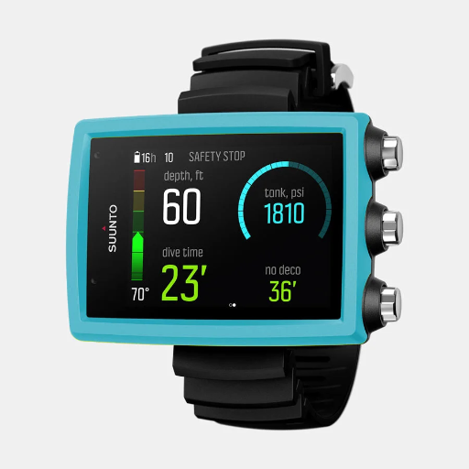
The pre-dive computer check
DEVICE READINESS
Suunto EON Core
Battery or charge sufficient
Correct units
Secure strap
Readable screen
CALCULATION SETTINGS
Correct scuba mode
Correct breathing gas
Appropriate oxygen limit
Understand conservatism
and altitude settings
Imperial display: ft and psi
14
Notes:
Gauge mode generally provides depth and time without decompression calculations. Confirm that you have selected the intended scuba mode. For a single-gas dive, check that additional gases cannot unintentionally affect the ascent calculation.
Activity: members check their own unit, including the Cressi Leonardo or Mares Puck Pro / Pro+ where available. Do not change settings without understanding them.
Sources supplied by organiser:
https://cdn.shopify.com/s/files/1/0838/3732/1530/files/Peregrine_Manual-metric_2021.pdf?v=1710186733
Image supplied by organiser: Suunto EON Core. Product display example only, not a dive plan. Refer to the model’s current manual. Image pixels and readings have not been altered.
The supplied EON Core image uses feet and psi. It is a product display, not a live safety-stop demonstration. Use it here to reinforce checking units, not to prescribe stop behaviour.
Discuss each diver’s settings and plan to the more restrictive limits. Do not change conservatism merely to make displays match. Altitude settings must suit the actual conditions and the manufacturer’s instructions.

Slide 15
Nitrox settings
01
Personally analyse your cylinder
1.4
02
Confirm oxygen percentage and MOD
03
Enter the measured mix as instructed
bar ppO₂
04
Check the oxygen partial-pressure limit
BSAC limit for
travel and
bottom phases
Repeat the check whenever you change cylinders.
15
Notes:
BSAC limits oxygen partial pressure to 1.4 bar for travel and bottom phases. Higher decompression limits require appropriate qualifications. Nitrox can extend no-stop time, but its increased oxygen content also limits depth. Personally analyse the cylinder, confirm its oxygen percentage and MOD, enter the measured mix following the manufacturer’s instructions, check the oxygen partial-pressure limit, and repeat whenever changing cylinders.
Sources supplied by organiser:
https://www.bsac.com/safety/safe-diving-guide/gas/

Slide 16
Warning-response practice
SUUNTO ZOOP NOVO MANUAL EXAMPLES
During ascent
During a nitrox dive
SLOW blinks and an alarm sounds.
PO₂ blinks: the configured oxygen partial-pressure limit is exceeded.
What does it mean?
What would you do next?
What does it mean?
What would you do next?
Find the matching warning in your own manual. Symbols and limits vary by model.
16
Notes:
Allow about three minutes. These are text descriptions of real Zoop Novo warnings from the manufacturer, not simulated computer screens. Have the current manual open for members to inspect its authentic warning examples. Ask for the meaning and next action before giving the answers.
Ascent answer: blinking SLOW indicates the model's maximum ascent rate has been exceeded. Reduce ascent rate and maintain buoyancy control, following training and the manual. The Zoop Novo guidance specifies 10 m/min for this alarm; this is not a universal limit for all devices.
Oxygen answer: blinking PO2 in this scenario means the selected oxygen partial-pressure limit has been exceeded and the current depth is too deep for the gas in use. For this single-gas exercise, signal the buddy and promptly reduce depth with a controlled ascent to within the gas's MOD, following training and the computer's instructions. Do not rush to the surface, change the entered gas to silence the alarm, or alter the oxygen limit underwater. This is a depth/ppO2 warning, not a CNS/OTU exposure alarm. Discuss those separately only if appropriate.
Acknowledge that the manufacturer's broader guidance also covers trained gas switching. That is outside this single-gas club exercise. A qualified instructor should confirm responses against the actual models and qualifications in the room.
Source:
https://www.suunto.com/Support/Product-support/suunto_zoop_novo/suunto_zoop_novo/features/alarms-warnings-and-notifications/

Slide 17
What happens with the wrong gas setting?
CYLINDER: AIR
CYLINDER: 32% NITROX
Computer: 32% nitrox
Computer: air
Assumes less nitrogen than
you are breathing
Nitrogen calculations are
generally more conservative
May display excessive
no-stop time
Oxygen warnings do not
represent the actual mix
Which mistake could encourage you to stay too long?
17
Notes:
The second situation still needs deliberate oxygen-depth planning. For normal use, match the analysed cylinder and computer settings.
Discussion: Which mistake could quietly encourage you to stay too long? The air cylinder with a computer set to 32% nitrox can show excessive no-stop time.
Sources supplied by organiser:
https://www.bsac.com/safety/safe-diving-guide/gas/

Slide 18
When the computer enters decompression
THE DISPLAY CHANGES
UNPLANNED FOR OCEAN DIVERS
The no-stop allowance has run out
Signal your buddy.
End the bottom
phase.
A ceiling or stop depth appears
Required stop time appears
Follow the computer’s required stops during a controlled ascent. Monitor gas.
Estimated ascent time may increase
18
Notes:
For an Ocean Diver, this is an unplanned situation. Signal your buddy, end the bottom phase and make a controlled ascent following the computer’s required stop instructions, while monitoring gas. Stay at or deeper than the displayed ceiling and within the model’s stop zone. Remaining at depth can increase the obligation.
Sources supplied by organiser:
https://us.suunto.com/pages/suunto-ocean-user-guide
Distinguish a ceiling from a stop-depth instruction: the ceiling is the shallowest permitted depth during required decompression. Stay at or deeper than that ceiling and within the model’s stop zone. Required stops are not the same as a recommended safety stop.

Slide 19
Reading a decompression display
ILLUSTRATIVE READINGS ONLY
Field | Reading
Current depth | 12 m
Required stop | 6 m
Stop time | 2 min
Time to surface | 5 min
2 min
is only part of
the ascent
One hypothetical example, not a dive plan or a model-specific screen.
TTS is an estimate. Follow updated instructions during ascent.
19
Notes:
One hypothetical example only: current depth 12 m, required stop 6 m, stop time 2 min, estimated TTS 5 min. These are illustrative values, not a dive plan or a model-specific screenshot. The two-minute stop is only part of the ascent. TTS includes ascent and required stops according to the computer's assumptions and may change. Follow updated instructions. A ceiling is the shallowest permitted depth during required decompression. This does not qualify an Ocean Diver to plan decompression dives.
Source: https://us.suunto.com/pages/suunto-nautic-user-guide

Slide 20
Missed stops and lockouts
A ceiling violation can trigger warnings
Some computers impose a lockout
Lockout behaviour differs between models
MISSED REQUIRED DECOMPRESSION
Do not re-enter the water.
Give oxygen and seek emergency advice immediately,
even without symptoms.
20
Notes:
For example, the Suunto D5 can lock its decompression algorithm for 48 hours following a prolonged ceiling violation. Lockout behaviour differs between models. BSAC advises that a diver who misses required decompression should not re-enter the water. Give oxygen and seek emergency advice immediately, even without symptoms.
Sources supplied by organiser:
https://www.suunto.com/en-im/Support/Product-support/suunto_d5/suunto_d5/features/algorithm-lock/
https://www.bsac.com/safety/safe-diving-guide/decompression/

Slide 21
If your computer fails
01
Signal your buddy
02
Abort the dive
03
Make a controlled ascent with your buddy
If available, use a personal backup that recorded the full dive.
Review further diving with the Dive Manager.
Club procedure: abort the dive, even if there is no personal backup.
21
Notes:
Club procedure confirmed by the organiser: if a dive computer fails, abort the dive. This also applies if there is no functioning personal backup. Signal your buddy, end the dive and make a controlled ascent together using the agreed abort procedure and your training. Aborting does not mean an uncontrolled ascent or permission to ignore known required decompression.
If available, use a functioning personal backup that recorded the full dive to support the ascent. A buddy’s computer cannot reconstruct your individual history, and neither can a spare switched on after the failure. Do not use a backup as a reason to continue the dive. Review further diving with the Dive Manager.
Brief the abort procedure before entering the water, including the equipment available to monitor ascent. This slide states the club's decision to abort; it does not prescribe a universal substitute decompression schedule.
Sources: club abort-dive decision supplied by the organiser on 12 October 2026. Existing manufacturer guidance on personal backup and individual dive history:
https://cdn.shopify.com/s/files/1/0838/3732/1530/files/Peregrine_Manual-metric_2021.pdf?v=1710186733

Slide 22
After the dive
REVIEW THE DIVE
24 h
Maximum depth and profile
Ascent warnings
before flying
where possible
PREPARE FOR THE NEXT DIVE
Confirm settings
BSAC guidance. Observe any longer restriction.
Consider the surface interval
22
Notes:
The surface interval does not instantly clear accumulated nitrogen. Use your own computer when planning subsequent dives. BSAC suggests waiting 24 hours before flying where possible. Also observe any longer restriction applicable to your computer or circumstances.
Sources supplied by organiser:
https://www.suunto.com/Support/Product-support/suunto_nautic/suunto_nautic/dive-planner/how-to-plan-a-no-decompression-dive/
https://www.bsac.com/safety/safe-diving-guide/decompression/

Slide 23
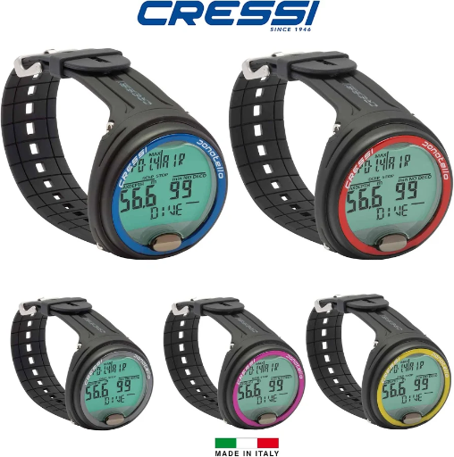
Getting to know your own computer
Seven-minute practice: find or explain these on your own model
Cressi Leonardo
1 Current gas setting
2 No-stop planner
3 Ascent-rate warning
4 Safety-stop depth range
5 Decompression display
6 Oxygen warning or unfamiliar symbol
Zoop Novo / Puck Pro & Pro+ / Leonardo / D5 / Peregrine & TX
Know your settings. Check throughout the dive.
Leave yourself a margin.
23
Notes:
Allow seven minutes for members to locate the six items, using current manuals and grouping by model. The surface screen may not expose all dive fields, so use a manual dive-screen image where needed. Keep the existing model-specific controls and depth ranges distinct.
Then allow three minutes for two decision checks and closing remarks:
1. At 18 m, your NDL is eight minutes and your buddy's is four. Which limit governs the next action? Expected answer: act on the more restrictive limit and leave a margin, alongside the gas plan.
2. Is a safety stop the same as required decompression? Expected answer: no. Distinguish a recommended safety stop, any model-specific mandatory safety stop and required decompression. Follow the actual display, training and manual.
Ask members to explain the response, not just identify a menu item. Close with: know your settings, check throughout the dive and leave a margin.
The main session ends here. The remaining three slides are optional technical references.
Model references:
https://www.suunto.com/Support/Product-support/suunto_zoop_novo/suunto_zoop_novo/
https://www.mares.com/product/puck-pro-7
https://store.cressi.com/products/leonardo-computer
https://us.suunto.com/pages/suunto-d5-user-guide
https://shearwater.com/pages/peregrine-support
Image: organiser-supplied Cressi Leonardo product photograph; not a warning demonstration.

Slide 24
Decompression algorithms
Optional reference: two algorithm families used in this session
Bühlmann + gradient factors
RGBM and Fused RGBM
Tracks dissolved inert gas in theoretical tissue compartments.
Gradient factors modify the model’s permitted supersaturation.
Combines dissolved-gas calculations with modelled bubble effects.
Manufacturer implementations and settings differ.
Every model estimates risk. None measures your body’s actual gas loading.
24
Notes:
Allow about 1½ minutes. Divers often call these formulas, but each computer uses an algorithm: a model plus gas calculations, settings and implementation rules. This overview focuses on the families represented in this session, not every model ever sold. Bühlmann ZH-L16 uses 16 theoretical compartments. RGBM means Reduced Gradient Bubble Model. A bubble-aware algorithm does not measure bubbles in the diver. No family guarantees freedom from decompression illness. Avoid declaring one model universally safest or treating the longest NDL as best. This section explains the mathematics, not how to plan unqualified decompression dives.
Sources:
https://en.wikipedia.org/wiki/B%C3%BChlmann_decompression_algorithm
https://shearwater.com/blogs/community/flexible-control-of-decompression-stress
https://www.suunto.com/Support/Product-support/suunto_eon_core/suunto_eon_core/features/decompression-algorithms/
Optional reference after the main session. Do not reduce the seven-minute own-computer exercise to cover this material. Use only if time remains or at a separate follow-up.

Slide 25
Which algorithm does your computer use?
OPTIONAL REFERENCE
Computer | Algorithm / choice
Shearwater Peregrine | Bühlmann ZHL-16C with gradient factors
Mares Quad Ci | Bühlmann ZH-L16C
Suunto Zoop Novo | Suunto RGBM
Cressi Leonardo | Cressi RGBM
Suunto D5 | Suunto Fused RGBM 2
EON Core / EON Steel Black | Fused RGBM 2 or Bühlmann 16 GF*
*Availability depends on software. Check the model, version and selected algorithm.
25
Notes:
Allow about 2 minutes. Ask members to find their algorithm in their own manual or settings without changing it. The two Mares names in the deck are not interchangeable: the supplied photograph is Quad Ci, not Puck Pro. Likewise a Peregrine is not an EON. The current Suunto EON Core guide 4.0 and EON Steel Black guide 3.0 list both Fused RGBM 2 and Bühlmann 16 GF. Older software and older documentation may differ, so verify the actual unit. Do not identify the algorithm from a product photograph alone. Suunto cautions against changing the algorithm between dives while no-fly time calculation is active. Model mapping checked against available sources in October 2026.
Sources:
https://shearwater.com/products/peregrine
https://www.mares.com/en_US/product/quad-ci-414148
https://www.suunto.com/Products/dive-computers-and-instruments/Suunto-Zoop-Novo/Suunto-Zoop-Novo-Blue/
https://www.cressiusa.com/easyUp/file/instructions/IB_LEONARDO_EN.pdf
https://www.suunto.com/Support/Product-support/suunto_d5/suunto_d5/features/personal-setting/
https://www.suunto.com/Support/Product-support/suunto_eon_core/suunto_eon_core/features/decompression-algorithms/
https://www.suunto.com/Support/Product-support/suunto_eon_steel_black/suunto_eon_steel_black/features/decompression-algorithms/
Optional reference after the main session. Do not reduce the seven-minute own-computer exercise to cover this material. Use only if time remains or at a separate follow-up.

Slide 26
Optional: gradient factors
Conservatism settings change calculated limits.
BÜHLMANN-BASED CALCULATIONS
GF Low
GF High
Mainly influences
deeper decompression
Influences tolerated supersaturation near surfacing
Understand the effects before changing settings.
26
Notes:
Conservatism settings change calculated limits. Gradient factors modify Bühlmann-based calculations. GF Low mainly influences deeper decompression. GF High influences tolerated supersaturation near surfacing. Lower settings generally increase conservatism, but the effects depend on the profile and implementation. Gradient factors are not percentages of personal safety. Avoid changing them simply to match someone else’s NDL or shorten stops. Shearwater recommends understanding gradient factors before using custom settings.
Optional extension: ask Peregrine / Peregrine TX owners to locate their conservatism settings without changing them.
Sources supplied by organiser:
https://shearwater.com/blogs/community/surface-gf-teric-musings
https://shearwater.com/pages/peregrine-support
Optional reference after the main session. Do not reduce the seven-minute own-computer exercise to cover this material. Use only if time remains or at a separate follow-up.

